Slide 1
Towards Responsible Brain Research and Applications
Arleen Salles Ph.D
Uppsala University
Computational Neuroscience, Neurotechnology and Neuro-inspired Artificial Intelligence
Autumn School
October 28th 2021

Slide 2

Structure
Context and theory…
Before RRI
RRI
In practice…
Responsible Research in The Human Brain Project
AREA framework
Focus on
AI
Digital Twin of the Brain
Brain Computer Interfaces

Slide 3
Brain Research, Ethics, and Society
Promises and concerns
How to approach issues raised by research and innovation in general?

Slide 4
RRI: Context
Self regulation and codes of conduct
Beyond self regulation,
Traditional Approach
“neutral” scientists and technologists determine and assess risks
Law is main lense through which issues are understood
Applied Ethics (ELSI/ELSA)
Ethicists, social scientists attempt to bridge and harmonize societal and scientific and technological goals and concerns
Application of ethical theory and relevant principles (neutral normative tools)
Focus on negative implications/ damage control
Participative (RRI)
Introduced top down
Attempt to respond to citizens’ concerns about
the direction of science,
the unpredictability of its outcomes,
the deficiencies of risk assessment approaches,
the perceived societal need to be part of the discussion
(Landeweerd et al 2015)

Slide 5
Responsible Research and Innovation (RRI) EC
“an approach that anticipates and assesses potential implications and societal expectations with regard to research and innovation, with the aim to foster the design of inclusive and sustainable research and innovation” (https://ec.europa.eu/programmes/horizon2020/en/h2020-section/responsible-research-innovation)
societal actors (researchers, citizens, policy makers, business, third sector organisations, etc.) work together during the whole research and innovation process in order to better align both the process and its outcomes with the values, needs and expectations of society.

Slide 6
Understandings of RRI
a transparent, interactive process by which societal actors and innovators become mutually responsive to each other with a view on the (ethical) acceptability, sustainability and societal desirability of the innovation process, and its marketable products (in order to allow a proper embedding of scientific and technological advances in our society)” Von Schomberg, 2011)
“on-going process of aligning research and innovation to the values, needs and expectations of society” (Rome Declaration 2014)

Slide 7
RRI: characteristics
Interactive process
Mutual responsiveness and joint reflection on the purpose of science and its outcomes
Discourse beyond a narrow construction of ethics simply as “applied ethics” or safety assessment
Legal, ethical and social issues should feed into the scientific research agenda
Development of reflection mechanisms for open discussion
Reconceptualization of the notion of responsibility
(Von Schomberg 2013) (Owen 2012, Stilgoe 2013, Owen 2013).

Slide 8

RRI in practice: the Human Brain Project
EU Future and Emerging Technologies (FET) Flagship Initiatives
One of the biggest EU-funded research projects (approximately 400 million Euros from the EU Framework Programmes (FP7 and Horizon 2020)
500 researchers and engineers based in more than 100 universities, research institutes, and hospitals in some 20 countries
Aims
Support and develop multidisciplinary information and communication technology (ICT) for neuroscience research.
Achieve a more integrated understanding of the human brain, leading to medical and technological applications (Amunts et al. 2019).
Develop a research infrastructure that provides data, tools and computing facilities via six open-access platforms. Future sustainable research infrastructure: EBRAINS

Slide 10
RRI Dimensions: AREA Framework
ANTICIPATE: Foresight analyses of social and ethical concerns
Identify potential ethical and social concerns at an early stage
REFLECT: Conceptual analyses and researcher awareness
on the purposes, motivations for and potential implications of the research, and the associated uncertainties
ENGAGE: Public and stakeholder dialogue and feed-back
with a range of public communities and stakeholders, in an open and transparent manner, the implications of the work of the HBP in order to feedback the priorities and concerns by citizens into the project
ACT: Strategic pathways to social benefit
Integrating anticipatory ethical and social foresight, conceptual reflection, and public concerns into the management and strategy of the HBP itself by feeding the priorities and concerns of citizens and researchers into the project
Philosophical, conceptual

Slide 11
HBP Responsible Research and Innovation
Responsible Research and Innovation
Neuroethics and Engagement
Ethics Coordination and Communication
Gender mainstream,ing and diversity management
Scientific Coordination and
Ethics Support
Embedded Neuroethics tasks in Scientific WPs 1,2,3

Slide 12
Ethics and Society
Ethical, social, and philosophical analyses
Early identification of the ethical, social, and philosophical issues
Neuroethical and philosophical reflection (conceptual and applied)
Engagement with public and private stakeholders
Management and Compliance

Slide 13
HBP RRI: some lessons
In practice compliance issues tend to dominate the RRI agenda (Stahl et al 2021, Salles & Farisco 2020)
Interdisciplinary collaboration is challenging when implementing RRI (Stahl et al 2021)
Difficulty in measuring success
Challenge of going from research to outcomes (from research and innovation activities to the use of their outcomes)

Slide 14
Focus 1: Artificial Intelligence
“Artificial intelligence is not just a new technology that requires regulation. It is a powerful force that is reshaping daily practices, personal and professional interactions, and environments. For the well being of humanity is it crucial that this power is used as a force for good” (Taddeo, Floridi 2018)
What are the issues?
Different levels
At the technology level (general)
At the artefact level (for certain types of products… robots?)
At the application level (in different domains and for particular purposes: who does it benefit? who does it hurt? Impact?)
How to approach them? Guidelines?
”Human-centric”
Set of principles (design, development, implementation)
ART (accountability, responsibility, transparency)
Justice y fairness
Privacy
Respect and autonomy
Trust

Slide 15
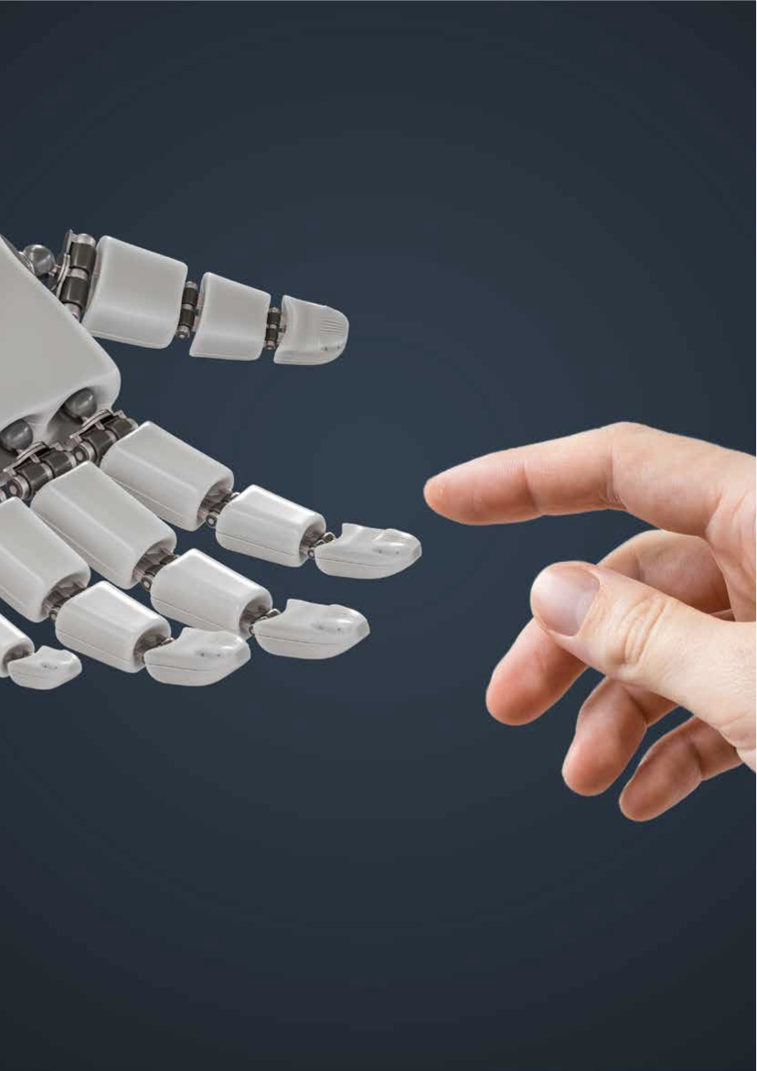

OECD Principles on Artificial Intelligence

Slide 16
Focus 2: Digital Twin of the Brain
Digital Twin (DT), (engineering concept) a computational model or digital replica of a living or non-living physical object or process
Expanded to healthcare:
Digital Twin of the Brain: construct that offers an explicit and formal account of the human brain (or a particular person’s brain)
Goal is to significantly enhance clinical practice, drawing better diagnosis, prognosis, and providing patient tailored treatments
Some Issues to consider
Empirical
When modelling the brain, to what extent are phenotypic variability and neuronal epigenesis taken into account? And to the extent that variability (individual or contextual) is not taken into account, what does that imply for the reliability of the models?
Conceptual
Use of terms “twinness” and “virtual brain”
Philosophical
Relation between twin and original brain
Ontological and ethical status of the model
The engineering paradigm inherent to a Digital Twins based health care will raise novel ethical, legal and social issues for therapy and enhancement K. Bruynseels*, F. Santoni de Sio & JJ van den Hoven (2018)
Ethical/societal
Privacy and data protection
Ownership and control
Potential misuses
misleading communication
Who will have access?

Slide 17
Focus 3: Brain Computer Interfaces
BCI set of technologies that can detect the activity of the brain directly abd translates them into “executable output by a machine” (Burwell et al 2017)
Potential applications
Assistive technology
Rehabilitatiobn
Some ethical issues
Informed consent
Distinction between research and treatment
Safety
Impact on humanness
Discrimination and biases
Responsibilty
privacy

Slide 18
Discussion
Integration of ethical and societal considerations in research and innovation programs from the beginning
Attention to meanings and contexts
Promote researchers’ awareness of the significance of these issues in their work. Importance of integration of reflection in the social sciences and the humanities
Recognition of the need for socially responsive AI research and technology. Inclusion of different stakeholder groups in agenda setting.
Engagement with different stakeholders: inclusion is key in identifying problems and designing solutions

Slide 19
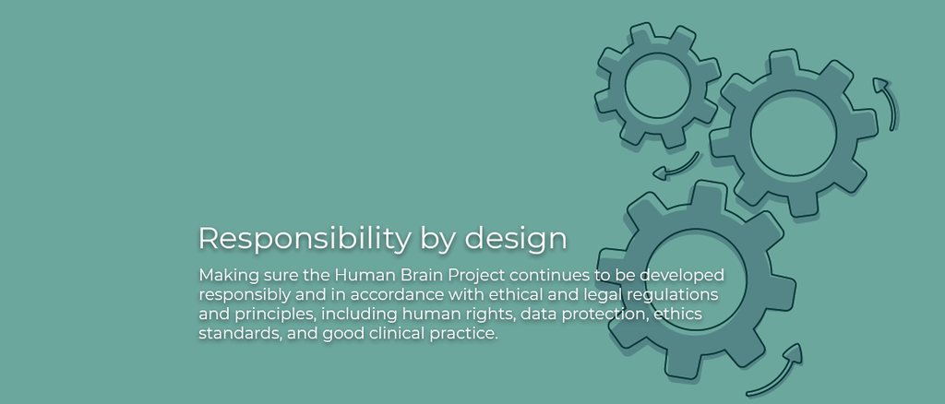
From RRI to RbD?
Responsibility by design
More emphasis on anticipation
Responsibility
part of the preparation and making of decisions
not limited to research projects and laboratories
Not an external imposition

Slide 20
Bibliography
Burwell S et al Ethical Aspects of Brain Computer Interfaces. (2017) BMC Medical Erthics 18:60.
Bruynseels, K., de Sio, F., & van den Hoven, J. (2018). Digital Twins in Health Care: Ethical Implications of an Emerging Engineering Paradigm. Frontiers in Genetics, 9.
Evers K. Salles A. (forthcoming 2021) Epistemic Challenges of Digital Twins & Virtual Brains: Perspectives from Fundamental Neuroethics. Scio Journal of Philosophy.
Farisco M, Evers K, Salles A. (2020) Towards establishing criteria for the ethical analysis of AI. Science and Engineering Ethics 26: 2413-2425
Jansen P & Brey P Ethical Analysis of AI and Robotics technologies. SIENNA D4.4.
Landeweerd et al. Life Sciences, Society and Policy (2015) 11:8 DOI 10.1186/s40504-015-0026-y
Von Schomberg, R. 2013. A vision of responsible research and innovation. In Responsible In novation, ed. R. Owen, M. Heintz, and J. Bessant. Chichester, UK: Wiley & Son.
Owen, R., P. Macnaghten, and J. Stilgoe. 2012. Responsible research and innovation: From science in society to science for society, with society. Science and Public Policy 39: 751–760.
Owen, R., J. Stilgoe, P. Macnaghten, M. Gorman, E. Fisher, & D. Guston. 2013. A framework for responsible innovation. In Responsible Innovation, ed. R. Owen, J. Bessant, and M. Chichester Heintz. UK: John Wiley & son.
Salles A. Evers K. Farisco M (2020) Anthropomorphism in AI. AJOB Neuroscience 11(2) 88-95.
Salles A. et al (2019) The Human Brain Project: Responsible Brain Research for the Benefit of Society. Neuron 101:3 DOI https://doi.org/10.1016/j.neuron.2019.01.005
Salles A. Farisco M. Evers K. (2018) Neuroethics and Philosophy in Responsible Research and Innovation: the case of the HBP. Neuroethics https://link.springer.com/article/10.1007/s12152-018-9372-9
Stahl B, et al (2021) From Responsible Research and Innovation to Responsibility by Design. Journal of Responsible Innovation https://doi.org/10.1080/23299460.2021.1955613
Stilgoe, J., R. Owen, and P. Macnaghten. 2013. Developing a framework for responsible innovation. Research Policy 42:1568–1580.

Slide 21
Follow me on Twitter: @arleensalles

